Slide 1
Persistence Layer using Spring Boot

Slide 2
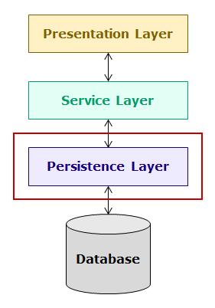
Introduction to Persistence Layer
The persistence layer interacts with relational database and the service layer. It gets data from service layer, performs operations on database and sends back results to service layer. The code to interact with database is implemented in this layer. In this course, you will learn development of persistence layer using Spring ORM and Spring Data.

Slide 3
In this course, you will understand the concepts of persistence layer by developing a banking application named hndBank containing multiple modules. One of the modules of this application is Customer module which has the following functionalities:
Add customer
Edit customer details
View all customers
Delete customers
You will develop the Customer module of this application using multi-tiered architecture as shown below:

Slide 4
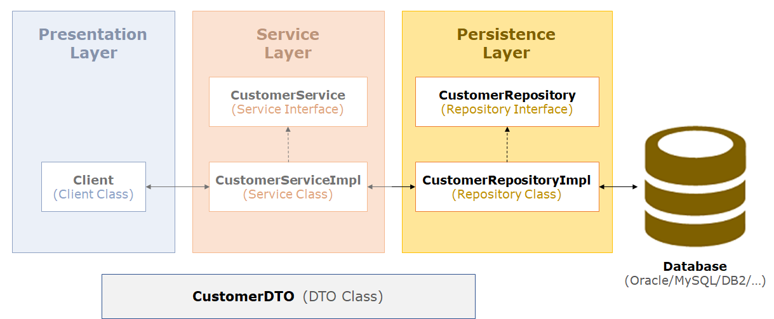

Slide 5
For better understanding, we have considered only Repository implementation to explain the concepts.
Spring is a popular framework for enterprise application development. For implementing persistence layer, it provides many approaches. The developer can choose appropriate Spring modules such as Spring JDBC or Spring ORM to integrate with JPA, Hibernate etc. for implementing the data access layer of an enterprise application.
Spring further simplifies development of persistence layer using Spring Data, which is an umbrella project supporting both relational and non-relational databases effectively. It provides a consistent persistent layer code with minimal coding from the developer thereby eliminating a lot of developer effort.
In this course, you will learn how to develop persistence layer of an application using
Spring ORM
Spring Data
Spring JDBC (refer to appendix)
Now let us start learning Spring ORM.

Slide 6
Object Relational Mapping
You already know how to use JDBC for developing persistence layer of an application. The JDBC code involves both Java objects (object model) and SQL queries (relational model). This makes it difficult to use because object model needs to be converted to relational model and vice versa. For example, for executing SQL select query the values present in Java object needs to be copied into SQL query but this conversion is not easy because of paradigm mismatch between object and relational model. This paradigm mismatch is called as Object-Relational Impedance Mismatch and it exposes following problems :
Problem of Granularity
This problem is that in object model, data can be present in more than one object but in relational model it is present in one table, i.e the object model is more granular than the relational model. For example, in object model you can have two separate classes, one for customer and the other for his address but in relational model, data about customer and his address can be stored in single table as shown below:

Slide 7
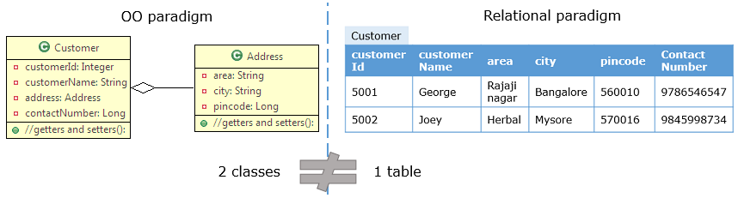
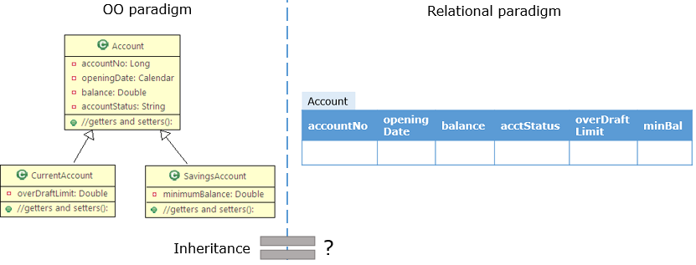
Problem of Inheritance
This problem is that in object model, you can create classes having inheritance relationship but in relational model there is nothing that can define inheritance.

Slide 8
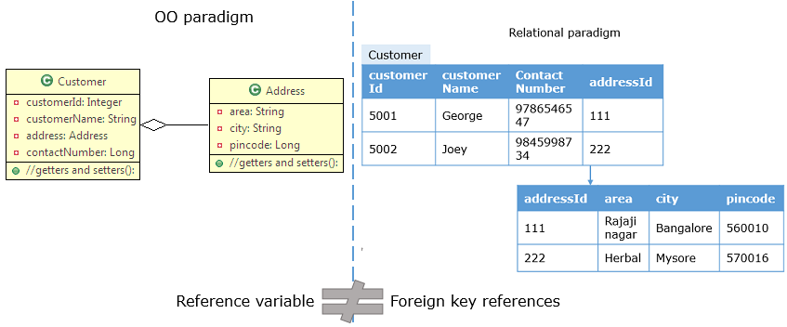
Problem of Identity
This problem is that the way in which equality of two objects is defined in object model is different for the way equality of two rows of a table is defined in relational model. For example, two rows in a table are same if they have same primary key values but two Java objects are equal if equals() method returns true.
Problem of Associations
This problem is that in object model, associations between objects is represented using references but in relational model, associations between tables is represented by foreign keys. Also, associations between objects can be unidirectional or bidirectional. However, in associations between tables there is no way to store information about directionality of relationship.

Slide 9
Problem of Data Navigation
This problem is that the way you access data in object model is different from the way you do it in a relational database. For example, in Java you navigate across association relationships using dot(.) operator but in relational model you navigate across related tables using joins.
To handle these problems, a technique called as Object-Relational Mapping (ORM) was introduced. It handles object relational impedance mismatch by providing a way to map Java objects to tables so that object model can be automatically translated to relation model and vice versa, allowing developers to focus only on the object model.
Now let us learn about ORM in detail.

Slide 10
Object Relational Mapping (ORM) is a technique or design pattern, which maps an object model with the relational model. It has the following features:
It resolves object-relational impedance mismatch by mapping
Java classes to tables in the database
Instance variables to columns of a table
Objects to rows in the table
It helps the developer to get rid of SQL queries so that they can concentrate on the business logic which leads to faster development of the application.
It is database independent. All database vendors provide support for ORM. Hence, the application becomes portable without worrying about the underlying database.
To use ORM in Java applications, Java Persistence API (JPA) specification is used. It has many implementations such as Hibernate, OpenJPA, TopLink, EclipseLink, etc. In this course we will use Hibernate implementation.
Now let us learn more about JPA.

Slide 11
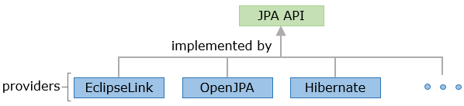
Java Persistence API (JPA)
The Java Persistence API (JPA) is a specification that defines standard for using object relational mapping (ORM) in Java applications for interacting with relational database. It provides :
API to map classes with tables
API for performing CRUD operations
Java Persistence Query Language (JPQL), a querying language for fetching data from database
Criteria API which uses object graph to fetch data from database
There are multiple providers available in market which provides implementation of JPA specification such as EclipseLink, OpenJPA, Hibernate, etc. as shown below:

Slide 12
Defining Entity Classes
The classes which are mapped to a table and whose instance represents a row in table are entity classes. JPA provides annotations to create entity classes which are present in the javax.persistence package. Some of these annotations are as follows:
@Entity : It specifies that the Java class is an entity class.
@Entity
public class Customer {
//rest of the code
}
@Id : Every object of entity class must have an attribute which uniquely identifies it. This is called as primary key attribute or identifier. Usually, it is the attribute mapped to the primary key column of table. It is specified using @Id annotation.

Slide 13
@Entity
public class Customer {
@Id
private Integer customerId;
//rest of the code
}
@Table : It specifies the table with which entity class is mapped. By default, entity class is mapped with a table which has same name as the class name. If entity class has to be mapped with a table whose name is different from class name then, this annotation is used. For example, if CustomerDetails class has to be mapped with customer table then the annotation needs to be used as follows:
@Entity
@Table(name="customer")
public class CustomerDetails {
@Id
private Integer customerId;
//rest of the code
}

Slide 14
@Column : It specifies the name of column in table with which attribute in entity class is mapped. By default, column name is mapped with a column which has same name as the attribute name. If attribute name is different from column name, then this annotation is used. For example, if customerId is to be mapped to customer_id column, then the annotation needs to be used as follows:
@Entity
@Table(name="customer")
public class Customer {
@Id
@Column(name="customer_id")
private Integer customerId;
//rest of the code
}
@Transient : It specifies the attributes which are not stored in table.
Consider the CUSTOMER table given below and its corresponding Customer entity class :

Slide 15
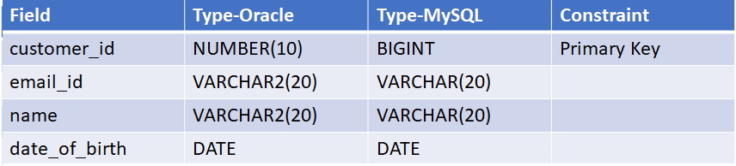


Slide 16
@Entity
public class Customer {
@Id
@Column(name="customer_id")
private Integer customerId;
@Column(name="email_id")
private String emailId;
private String name;
@Column(name="date_of_birth")
private LocalDate dateOfBirth;
//getter and setters
}
In the above code, the name of attributes customerId, emailId and dateOfBirth are different from the column names. So, @Column annotation is used.

Slide 17
Sometimes, entity class has a reference of enum and if you want to persist it, you can use @Enumerated annotation. For example, consider the following Java class which as a reference to CustomerType enum and you have to map it to CUSTOMER table in the database:
public class Customer {
private Integer customerId;
private String emailId;
private String name;
private LocalDate dateOfBirth;
private CustomerType customerType;
//getters and setters
}
public enum CustomerType{
SILVER,GOLD,PLATINUM;
}

Slide 18

CUSTOMER Table:

Slide 19
This can be done using JPA annotations as follows:
@Entity
public class Customer {
@Id
@Column(name="customer_id")
private Integer customerId;
@Column(name="email_id")
private String emailId;
private String name;
@Column(name="date_of_birth")
private LocalDate dateOfBirth;
@Enumerated(EnumType.STRING)
private CustomerType customerType;
//getters and setters
}

Slide 20
In the above code, CustomerType is annotated with @Enumerated annotation. The EnumType property is used to specify how the enum should be persisted in the database.
The possible values of EnumType property are as follows:
@Enumerated(EnumType.STRING) specifies that the enum will be written and read from the corresponding database column as a String. So, customerType set to SILVER will be persisted as SILVER.
@Enumerated(EnumType.ORDINAL) specifies that the enum will be persisted as an integer value. So, customerType set to SILVER will be persisted as 0 and customerType set to GOLD will be persisted as 1. The default is EnumType.ORDINAL.

Slide 21
One of the best practices that should be followed while creating an Entity class is:
Override the equals() and hashCode() methods in the entity classes
The Customer entity class implementation shown to you is sufficient to map it to CUSTOMER table but it is considered as a good practice to override the equals() and hashCode() methods in the entity classes as shown below:
@Entity
public class Customer {
@Id
@Column(name="customer_id")
private Integer customerId;
@Column(name="email_id")
private String emailId;
private String name;
@Column(name="date_of_birth")
private LocalDate dateOfBirth;
@Enumerated(EnumType.STRING)
private CustomerType customerType

Slide 22
//getter and setters
@Override
public int hashCode() {
final int prime = 31;
int result = 1;
result = prime * result + ((this.getCustomerId() == null) ? 0 : this.getCustomerId().hashCode());
return result;
}
@Override
public boolean equals(Object obj) {
if (this == obj)
return true;
if (obj == null)
return false;
if (getClass() != obj.getClass())
return false;
Customer other = (Customer) obj;
if (this.getCustomerId() == null) {
if (other.getCustomerId() != null)
return false;
}
}

Slide 23
NOTE : The implementation of equals() and hashCode() methods will change based on the requirements.
Why overriding equals() and hashCode() methods in entity class is considered to be a good practice?
This is because each instance of an entity class represents a row in database and in real time, you may have many objects of this class. So, you need to differentiate one object from the other. JPA ensures that there is a unique instance for each row of the database but if you want to store the objects in a Set, then you need to override equals() and hashCode() methods.

Slide 24
A best practice that should be followed in mapping an Entity class is:
Avoid database tables associated to more than one entity, i.e., one single table in the database should be associated with only one entity
While mapping entity classes and the database tables, it is advised to avoid database tables associated to more than one Entity. i.e; one single table in the database should be associated with one single entity.
What can be the possible reason for this?
Consider a scenario where two entities are mapped to the same database table.
The problem arises because Hibernate doesn’t know which entity represent the same database record. The disadvantage here is that, developers have to make sure they don’t fetch more than one entity type for the same database table record. Otherwise, this can cause inconsistencies when flushing the persistence context. Hibernate doesn’t refresh any of these entities if we update the other one as it handles them independently.
In such cases, review your design and decide which Entity must manage the table.
Thus, as a best practice while mapping an Entity to a database table, avoid tables associated to more than one Entity.

Slide 25
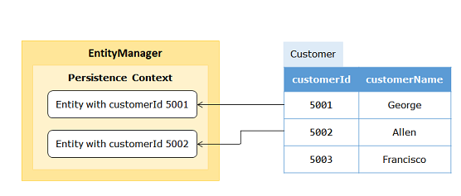
Persistence Context and EntityManager
You know that instance of entity object represents a row in the database table but you should be able to perform database operations using entity objects. For this, JPA provides EntityManager interface. You can use methods of this interface for interacting with database using entity objects. The group of objects of entity classes managed by an EntityManager is called as persistence context. Every instance of EntityManager has its own persistence context. At any time within the same EntityManager, there should exist only one entity object with the same primary key value.

Slide 26
Every entity object has a state in relation to both persistence context and the database. Every entity object has different states depending on its relationship with persistence context. This defines the life cycle of an entity object. The different states of an entity object during its life cycle are as follows:
New/Transient State : A newly created entity object which has no persistence context associated with it and having no row associated with it in a table in database is said to be in new or transient state.
Managed/Persistent State : An entity object which has a persistence context and an identifier value associated with it is said to be in managed or persistent state. It may or may not have a row associated with it in a table.
Removed State : An entity object which has a row associated with it in a table and associated with a persistence context, but marked for deletion from the database is said to be in removed state.
Detached State : An entity object which is no longer associated with a persistence context with which it was previously associated with it is said to be in detached state. This usually happens when session gets closed or the object was evicted from the persistence context.

Slide 27
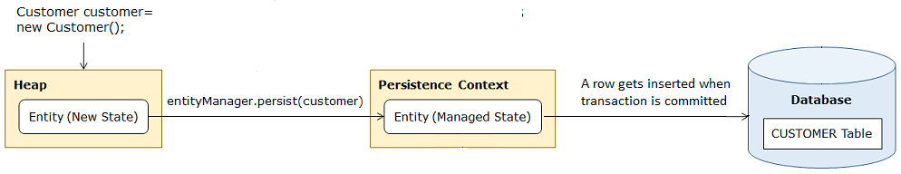
You will now have a look at some of the important methods of the EntityManager interface.
void persist(Object entity) - It makes a new entity object managed. When transaction is committed, a new row will be inserted in the database.
find(Class entityClass, Object primaryKey) - It searches the database table based on the primaryKey and returns the row as an object of entity class. It returns null if no row is present in the database. It returns the entity object in the managed state.

Slide 28
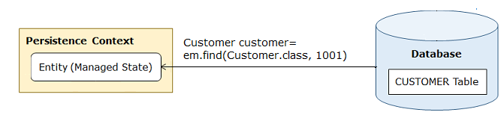
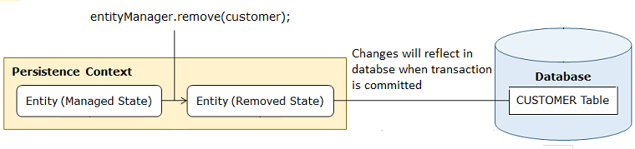
void remove(Object entity) - It changes the state of entity object from managed to removed and object gets deleted from the database when transaction is committed.

Slide 29
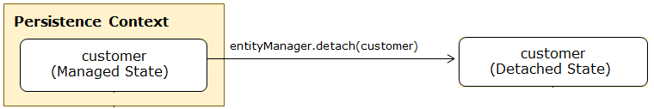
void detach(Object entity) - It detaches the given entity from the persistence context associated with it and changes its state to detached.
Now you will see how to use JPA with Spring Boot.

Slide 30
Creating and Configuring Spring Boot project with JPA - Demo
Objective:
To create and configure a Spring Boot project which uses JPA and MySQL database.
Steps:
Step 1 : Create a Spring Boot project
Using Spring Initializr, create a Spring Boot project with following specifications:
Spring Boot Version: 2.6.6 (The version keeps on changing, always choose the latest release)
Group: com.hnd
Artifact: Demo_SpringOrmCRUD
Name: Demo_SpringOrmCRUD
Package name: com.hnd
Java Version: 17
Dependencies: Spring Data JPA and MySQL Driver
Note: If you are using Oracle database, add the following dependency in pom.xml:

Slide 31
<dependency>
<groupId>com.oracle.ojdbc</groupId>
<artifactId>ojdbc8</artifactId>
<version>19.3.0.0</version>
</dependency>
Step 2: Open application.properties in src/main/resources folder and add following properties for MySQL and JPA:
# MySQL settings
#Change these settings according to database you are using
spring.datasource.url=jdbc:mysql://localhost:3306/customer_db
spring.datasource.username=root
#If MySQL installation is password proctored,then use below property to set password
spring.datasource.password=root
#JPA settings
spring.jpa.show-sql=true
spring.jpa.properties.hibernate.format_sql=true

Slide 32
spring.datasource.url : This property defines the JDBC URL of the database.
spring.datasource.username : This property defines the login username of the database.
spring.datasource.password : This property defines the login password of the database.
spring.jpa.show-sql : This property if set to true enables logging of generated SQL statements.
spring.jpa.properties.hibernate.format_sql : This property if set to true formats generated SQL statements in pretty format.

Slide 33
Read operation using JPA with Spring Boot - Demo
Objective:
To perform read operation using JPA with Spring Boot.
Steps:
Step 1: Open the project created in the previous demo.
Step 2: Create the database and table
Open MySQL terminal and execute the following command:

Slide 34
drop database if exists customer_db;
create database customer_db;
use customer_db;
create table customer(
customer_id int,
email_id varchar(50),
name varchar(20),
date_of_birth date,
customer_type varchar(10),
constraint ps_customer_id_pk primary key (customer_id)
);
insert into customer (customer_id, email_id, name, date_of_birth, customer_type) values (1, 'martin@hnd.com', 'martin', sysdate()- interval 9136 day, 'GOLD');
commit;
select * from customer;
Step 3: Create the following CustomerType enum in com.hnd.dto package:

Slide 35
package com.hnd.dto;
public enum CustomerType {
SILVER, GOLD, PLATINUM;
}
Step 4: Create the following CustomerDTO class in com.hnd.dto package
package com.hnd.dto;
import java.time.LocalDate;
public class CustomerDTO {
private Integer customerId;
private String emailId;
private String name;
private LocalDate dateOfBirth;
private CustomerType customerType;
public Integer getCustomerId() {
return customerId;
}

Slide 36
public void setCustomerId(Integer customerId) {
this.customerId = customerId;
}
public String getEmailId() {
return emailId;
}
public void setEmailId(String emailId) {
this.emailId = emailId;
}
public String getName() {
return name;
}
public void setName(String name) {
this.name = name;
}
public LocalDate getDateOfBirth() {
return dateOfBirth;
}
public void setDateOfBirth(LocalDate dateOfBirth) {
this.dateOfBirth = dateOfBirth;
}

Slide 37
public CustomerType getCustomerType() {
return customerType;
}
public void setCustomerType(CustomerType customerType) {
this.customerType = customerType;
}
@Override
public String toString() {
return "CustomerDTO [customerId=" + customerId + ", emailId=" + emailId + ", name=" + name + ", dateOfBirth="
+ dateOfBirth + "]";
}
}
Step 5: Create the following Customer entity class in com.hnd.entity package:

Slide 38
package com.hnd.entity;
import java.time.LocalDate;
import javax.persistence.Column;
import javax.persistence.Entity;
import javax.persistence.EnumType;
import javax.persistence.Enumerated;
import javax.persistence.Id;
import com.hnd.dto.CustomerType;
@Entity
public class Customer {
@Id
private Integer customerId;
private String emailId;
private String name;
private LocalDate dateOfBirth;
@Enumerated(value=EnumType.STRING)
private CustomerType customerType;

Slide 39
public Integer getCustomerId() {
return customerId;
}
public void setCustomerId(Integer customerId) {
this.customerId = customerId;
}
public String getEmailId() {
return emailId;
}
public void setEmailId(String emailId) {
this.emailId = emailId;
}
public String getName() {
return name;
}
public void setName(String name) {
this.name = name;
}
public LocalDate getDateOfBirth() {
return dateOfBirth;
}

Slide 40
public void setDateOfBirth(LocalDate dateOfBirth) {
this.dateOfBirth = dateOfBirth;
}
public CustomerType getCustomerType() {
return customerType;
}
public void setCustomerType(CustomerType customerType) {
this.customerType = customerType;
}
@Override
public String toString() {
return "Customer [customerId=" + customerId + ", emailId=" + emailId + ", name=" + name + ", dateOfBirth="
+ dateOfBirth + ", customerType=" + customerType + "]";
}
@Override
public int hashCode() {
final int prime = 31;
int result = 1;
result = prime * result + ((this.getCustomerId() == null) ? 0 : this.getCustomerId().hashCode());
return result;
}

Slide 41
@Override
public boolean equals(Object obj) {
if (this == obj)
return true;
if (obj == null)
return false;
if (getClass() != obj.getClass())
return false;
Customer other = (Customer) obj;
if (this.getCustomerId() == null) {
if (other.getCustomerId() != null)
return false;
}
else if (!this.getCustomerId().equals(other.getCustomerId()))
return false;
return true;
}
}

Slide 42
Note: Spring Boot uses SpringPhysicalNamingStrategy for physical naming. So while naming, camel casing is replaced by underscores and all table names are generated in lower case. So in the above entity class, @Column is not used for customerId because it will by default be mapped to customer_id column. Similarly, @Column is not used for emailId and dateOfBirth attributes.
Step 6: Create an hndBankException class in com.hnd.exception package:
package com.hnd.exception;
public class hndBankException extends Exception {
public hndBankException(String message) {
super(message);
}
}
Step 7: Create the LoggingAspect class in com.hnd.utility package as shown below:

Slide 43
package com.hnd.utility;
import org.aspectj.lang.annotation.AfterThrowing;
import org.aspectj.lang.annotation.Aspect;
import org.springframework.stereotype.Component;
import org.apache.commons.logging.Log;
import org.apache.commons.logging.LogFactory;
@Component
@Aspect
public class LoggingAspect {
public static final Log LOGGER = LogFactory.getLog(LoggingAspect.class);
@AfterThrowing(pointcut = "execution(* com.hnd.service.*Impl.*(..))", throwing = "exception")
public void logServiceException(Exception exception) {
LOGGER.error(exception.getMessage(), exception);
}
@AfterThrowing(pointcut = "execution(* com.hnd.repository.*Impl.*(..))", throwing = "exception")
public void logRepositoryException(Exception exception) {
LOGGER.error(exception.getMessage(), exception);
}
}

Slide 44
Step 8: Create the following CustomerRepository interface in com.hnd.repository package as shown below:
public interface CustomerRepository{
public CustomerDTO getCustomer(Integer customerId);
}
Step 9: Create the following CustomerRepositoryImpl class in com.hnd.repository package as shown below:
@Repository(value = "customerRepository")
public class CustomerRepositoryImpl implements CustomerRepository {
@PersistenceContext
private EntityManager entityManager;
public CustomerDTO getCustomer(Integer customerId) {
CustomerDTO customerDTO=null;
Customer customer = entityManager.find(Customer.class, customerId);

Slide 45
if(customer!=null){
customerDTO=new CustomerDTO();
customerDTO.setCustomerId(customer.getCustomerId());
customerDTO.setDateOfBirth(customer.getDateOfBirth());
customerDTO.setEmailId(customer.getEmailId());
customerDTO.setName(customer.getName());
customerDTO.setCustomerType(customer.getCustomerType());
}
return customerDTO;
}
}
This class is annotated with @Repository annotation, so that Spring automatically scans this class and registers it as the Spring bean. The EntityManager object is injected using @PersistenceContext annotation.
Step 10: Create the following CustomerService interface in com.hnd.service package as shown below:

Slide 46
public interface CustomerService {
public CustomerDTO getCustomer(Integer customerId) throws hndBankException;
}
Step 11: Create the following CustomerServiceImpl class in com.hnd.service package as shown below:
@Service(value = "customerService")
public class CustomerServiceImpl implements CustomerService {
@Autowired
private CustomerRepository customerRepository;
public CustomerDTO getCustomer(Integer customerId) throws hndBankException {
CustomerDTO customerDTO = customerRepository.getCustomer(customerId);
if (customerDTO == null) {
throw new hndBankException("Service.CUSTOMER_UNAVAILABLE");
}
return customerDTO;
}
}

Slide 47
Step 12: Modify the application.properties file and add the following property:
Service.CUSTOMER_UNAVAILABLE=Customer details not found. Give valid customer id.
Step 13: Modify the Application class as shown below:
@SpringBootApplication
public class DemoSpringOrmReadApplication implements CommandLineRunner{
public static final Log LOGGER = LogFactory.getLog(DemoSpringOrmReadApplication.class);
@Autowired
CustomerServiceImpl customerService;
@Autowired
Environment environment;
public static void main(String[] args) {
SpringApplication.run(DemoSpringOrmReadApplication.class, args);
}
@Override
public void run(String... args) throws Exception {
getCustomer();
}
public void getCustomer() throws hndBankException {
CustomerDTO customerDTO = customerService.getCustomer(1);
LOGGER.info(customerDTO);
}
}

